Slide 1
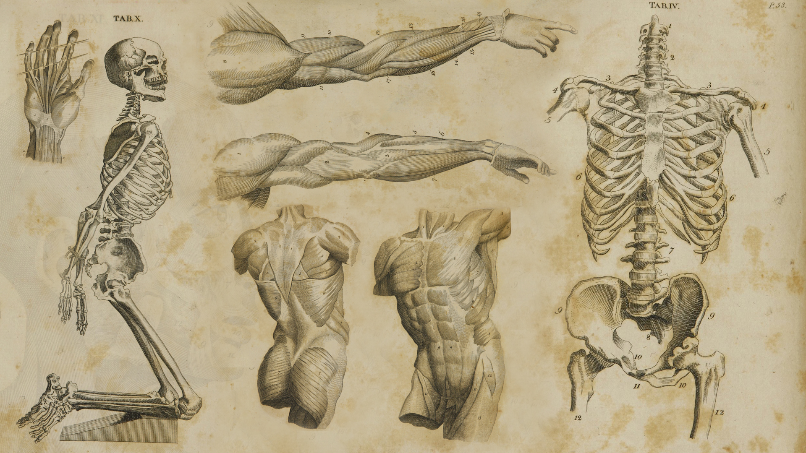
The Anatomy
of Appreciation
Genius Project // Human Anatomy
Rhea Mayekar

Slide 2
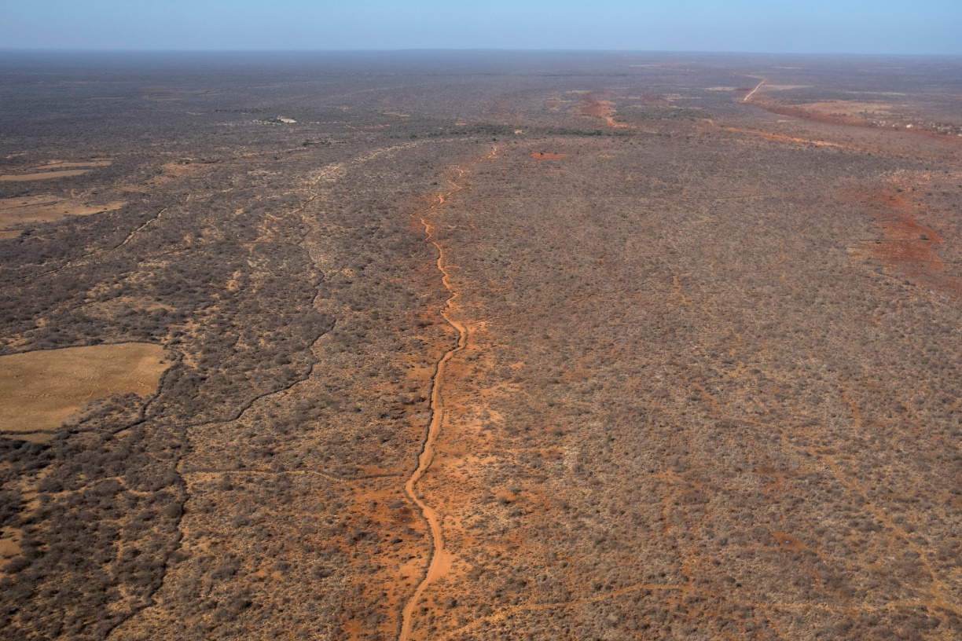
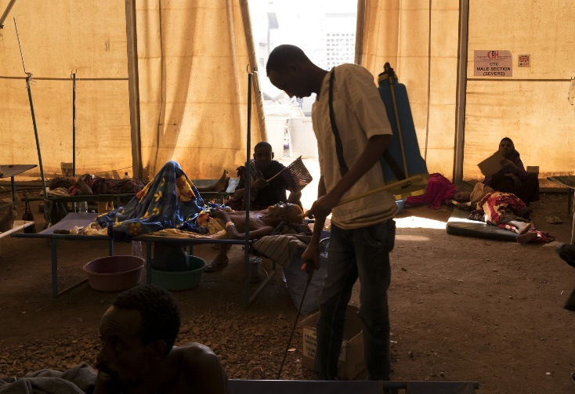
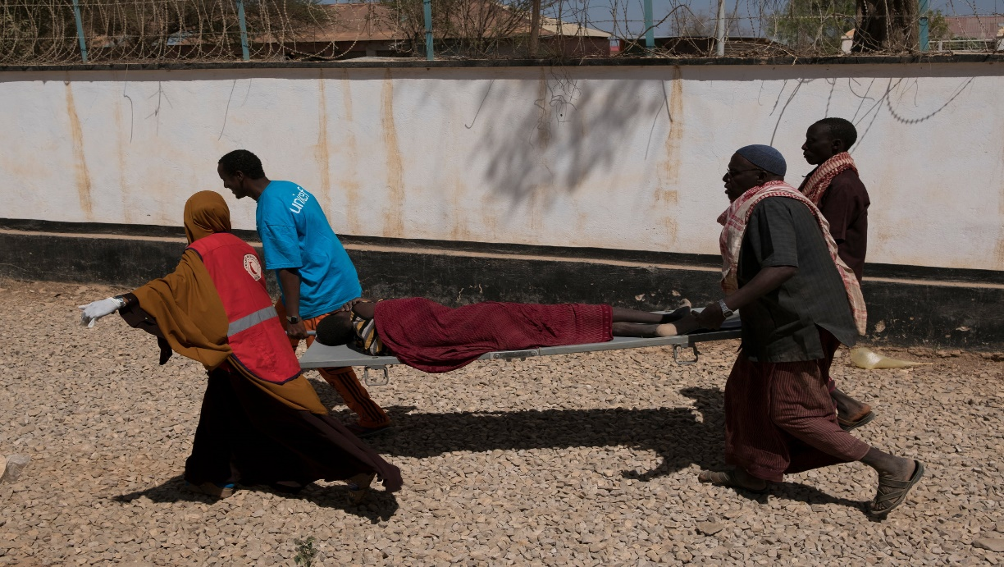
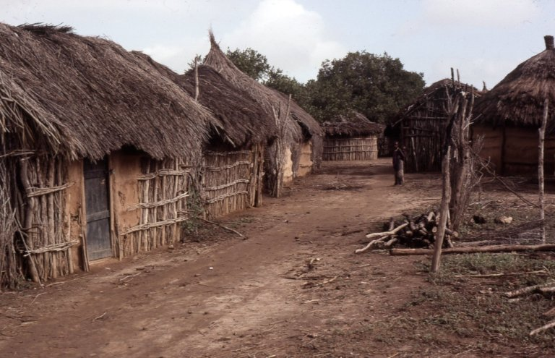

Slide 3
.
CIRCULATORY SYSTEM
1
.
2
RESPIRATORY SYSTEM
.
URINARY SYSTEM
3
.
4
NERVOUS SYSTEM
.
LYMPHATIC SYSTEM
5
.
6
SKELETAL SYSTEM

Slide 4
A WORK IN PROGRESS, NOT PERFECTION
33%
68%
100%
68% correctly
100% correctly

Slide 5
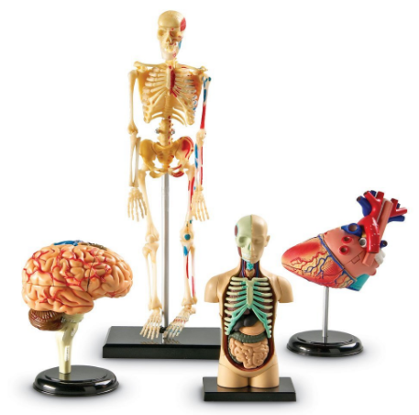
READY, SET, GO…

Slide 6
Nervous System
Respiratory System
Circulatory System
Lymphatic System
Gastrointestinal System
Urinary System
Endocrine/Reproductive System
Muscular/Skeletal System

Slide 7
Brain
Lungs
Heart
Liver
Stomach
Kidney
Spleen
Pancreas
Large/Small Intestine

Slide 8
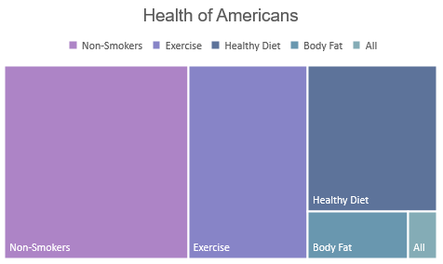
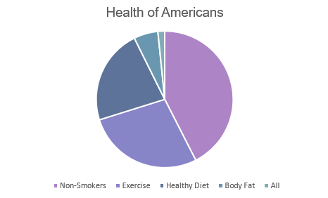
MAYO CLINIC FINDINGS

Slide 9
LEARNING TO APPRECIATE WHAT WE TAKE FOR ADVANTAGE
SCHOOL
LIFE
YOURSELF

Slide 10
APPRECIATION 101
KEEP A JOURNAL
PAY ATTENTION
BE PRESENT – BE INFORMED
START SMALL

Slide 11
ALERTNESS
APPRECATION
ENTHUSIASM
OPTIMISM

Slide 12
“
WE ALWAYS WANT WHAT WE DON’T HAVE.
“

